Slide 1


Fluctuation-Dissipation Relations for Stochastic Gradient Descent
Sho Yaida
[arXiv: 1810.00004]

Slide 2
Physics of Machine Learning
Dynamics of SGD
Geometry of loss-function landscape
Algorithms for faster/better learning
…
(SGD=Stochastic Gradient Descent)

Slide 3
Outline
01 FDR for SGD in theory
02 FDR for SGD in action
03 Outlook
(FDR=Fluctuation-Dissipation Relations
SGD=Stochastic Gradient Descent)

Slide 4
01 FDR for SGD in theory

Slide 5
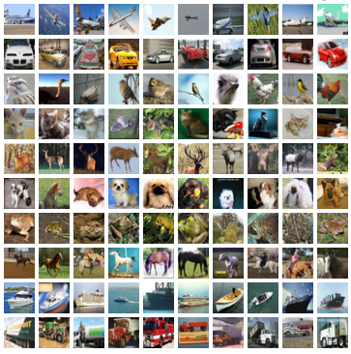

ML as optimization of the loss function
w.r.t. model parameters :
better accuracy with larger
MNIST
CIFAR-10

Slide 6
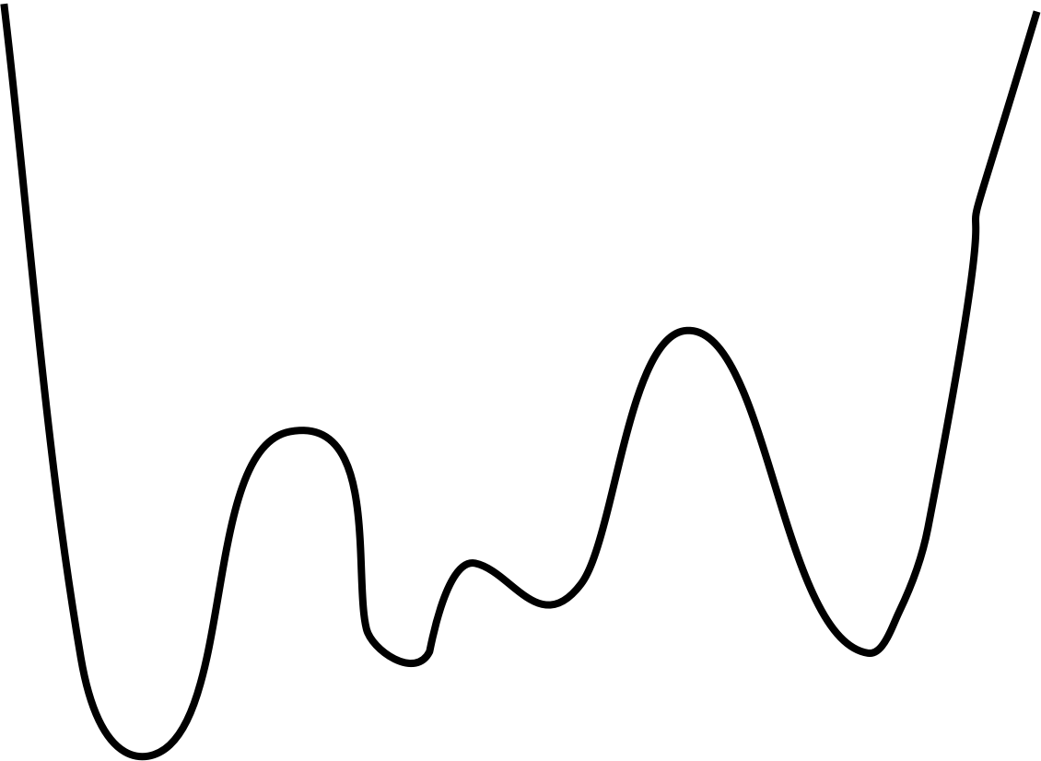
ML as optimization of the loss function
w.r.t. model parameters :
GD:

Slide 7
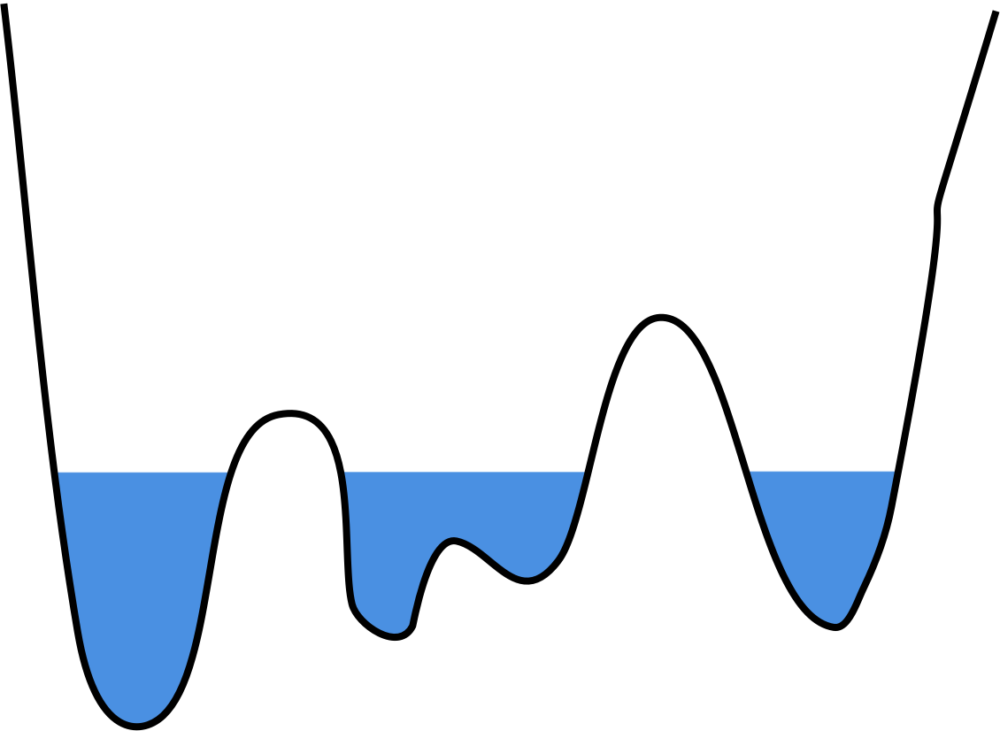
ML as optimization of the loss function
w.r.t. model parameters :
GD: better accuracy with larger but
computationally more expensive
SGD

Slide 8
SGD dynamics:
: model parameters
: learning rate
: mini-batch realization of size

Slide 9
Stationarity Assumption:
SGD sampling at long time is governed by stationary-state distribution
model parameters

Slide 10
Stationarity Assumption:
SGD sampling at long time is governed by stationary-state distribution
No quadratic assumption on loss surfaces
No Gaussian assumption on noise distributions

Slide 11
Stationarity Assumption:
SGD sampling at long time is governed by stationary-state distribution
stationary-state average

Slide 12

Stationarity Assumption:

Slide 13
song & dance

Slide 14
natural

Slide 15
Exact for any stationary states
Easy to measure on the fly
Use it to check equilibration/stationarity
Use it for adaptive training

Slide 16
Intuition within harmonic approximation
song & dance
height of noise ball ~ “temperature”

Slide 17
higher derivatives of loss
higher correlations of noise

Slide 18
Linearity for small :
Nonlinearity for high : breakdown of constant Hessian & constant noise-matrix approximation

Slide 19
02 FDR for SGD in action

Slide 20
checks equilibration/stationarity

Slide 21
checks equilibration/stationarity
Compare their (half-running) time averages
Expect

Slide 22
(dotted)
(solid)

Slide 23
Slope @ small : magnitude of Hessian
Nonlinearity @ high : breakdown of constant Hessian & constant noise-matrix approximation

Slide 24
MLP for
MNIST
CNN for
CIFAR-10
Slope @ small : magnitude of Hessian
Nonlinearity @ high : breakdown of constant Hessian & constant noise-matrix approximation

Slide 25
algorithmizes
adaptive training scheduling
Measure at the end of each epoch
If , then

Slide 26
algorithmizes
adaptive training scheduling
MLP for MNIST
CNN for CIFAR-10

Slide 27
03 Outlook

Slide 28
Physics of Machine Learning
Dynamics of SGD
Geometry of loss-function landscape
Algorithms for faster/better learning
…

Slide 29
for equilibration dynamics
for loss-function landscape
for adaptive training algorithm

Slide 30
Adaptive training algorithm for near-SOTA
Time-dependence (Onsager, Green-Kubo, Jarzynski,…)
in sample distribution: ads, lifelong/sequential/continual learning
quasi-stationarity: cascading overfitting dynamics in deep learning
etc.
Connection to whatever Dan is doing

